Slide 1
Fuzzing PANDAS
Data frames
Hector Acosta - 2022427831

Slide 2






Target System
Notes:
pandas is an important tool for AI and data science in general. It is a Python library that provides high-performance data manipulation and analysis tools for structured data. Some of the main features of pandas include:
Data manipulation
Data analysis
Data visualization
Data integration
In AI, pandas is often used for data preprocessing and data cleaning, which are important steps in the data pipeline. Data scientists and machine learning engineers use pandas to load, clean, and transform data into a format suitable for building and training AI models. Overall, pandas is an essential tool for anyone working with structured data in Python.

Slide 3
MOTIVATION + Objective
Target domain: Artifitial inteligence
Incentive: Is an important tool for AI and data science
Importance: A significant proportion of AI projects makes use of Pandas supported by prominent companies
Objectives: Identify defects and enhance efficiency
Notes:
pandas is an important tool for AI and data science in general. It is a Python library that provides high-performance data manipulation and analysis tools for structured data. Some of the main features of pandas include:
Data manipulation
Data analysis
Data visualization
Data integration
In AI, pandas is often used for data preprocessing and data cleaning, which are important steps in the data pipeline. Data scientists and machine learning engineers use pandas to load, clean, and transform data into a format suitable for building and training AI models. Overall, pandas is an essential tool for anyone working with structured data in Python.

Slide 4
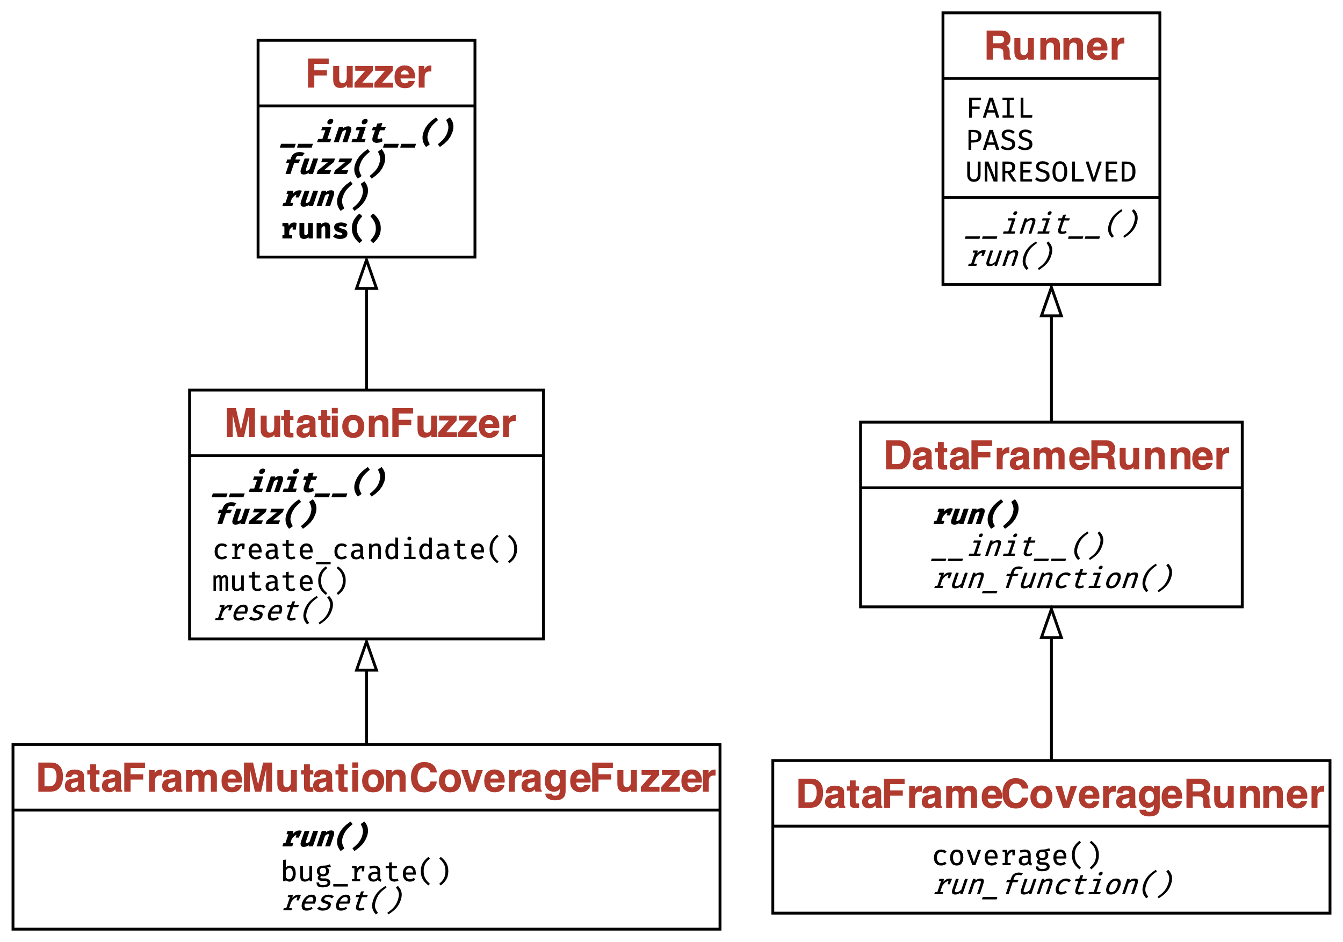
HOW TO RUN – Overview
Create DataFrame Runner that inherits from Base Runner Implementation (DataFrameRunner)
Create Coverage Runner that inherits from DataFrame Runner (DataFrameCoverageRunner)
Create Mutation Fuzzer that inherits from Fuzzer (MutationFuzzer)
Combine both DataFrameCoverageRunner and MutationFuzzer into DataFrameMutationCoverageFuzzer
---------------------------------------------------
In each run, it utilizes the DataFrameCoverageRunner to execute the target function with the fuzzed input and monitor the code coverage, and uses the MutationFuzzer to generate new, possibly unique, inputs (fuzzed input) through mutation of the initial inputs.

Slide 5
HOW TO RUN – INPUT
Attribute/Method | Type | Description
__init__() | Method | Initializes the DataFrameMethodArgs object with a DataFrame, arguments list, and keyword arguments dictionary
mutate() | Method | Applies random mutations to the DataFrame and keyword arguments
__str__() | Method | Returns a string representation of the DataFrameMethodArgs object
df | Attribute | The DataFrame to be mutated
method | Attribute | The method to run against the DataFrame
args | Attribute | List of positional arguments (unused in the current implementation)
DataFrame
Arguments
Mutable Input
Method

Slide 6
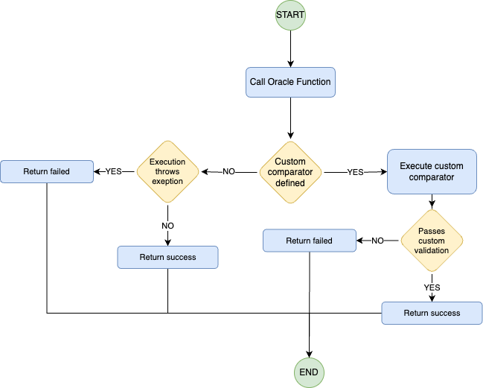
HOW TO RUN – ERROR/EXCEption Oracle
Function Oracle(test_output,
expected_output,
comparator = defaultComparator):
If test_output has an Error:
Return False
Else If comparator is not defaultComparator:
If comparator(test_output, expected_output) is True:
Return True
Else:
Return False
Else:
Return True

Slide 7
HOW TO RUN – PATCHED PANDAS Oracle
Function pandas_oracle(input_dataframe, expected_result):
# Step 1: Convert input_dataframe to a JSON string
input_as_json = convert input_dataframe to JSON
# Step 2: Use client to send input_as_json to the server and receive a response
client = new client for server communication
server_response = client.send input_as_json to server
# Step 3: Check if the server_response indicates an error
if server_response indicates error:
# Compare the error message with expected_result
return error message in server_response is equal to expected_result
else:
# Convert the response result to DataFrame
try:
result_dataframe = convert server_response to DataFrame
# Compare result_dataframe with expected_result
return result_dataframe is equal to expected_result
except:
return False

Slide 8
Metrics OBTAINED
Coverage
Bug Discovery Rate
Average time per cycle
CPU / Memory Usage

